Slide 1
Navigating Politics & Making Informed decisions

Slide 2
Acknowledgement of Country
I wish to acknowledge that we are all on Aboriginal land.
I pay my respects to Elders past and present.

Slide 3
Thank you for inviting me to present. And Welcome!
By the end of the session, you will be familiar with a tool to help you collate data to form compelling evidence and help communicate a strong argument or proposition to a range of stakeholders.
3

Slide 4
About Redwoods Work Collaborative
Redwoods upskills, resources and connects community organisations, businesses, local government and agencies so that they can get on with what they do best.
Our services include:
Research, consulting, problem solving.
Value creation: grants & funding alignment.
Staff development: evidence-based decision-making best practices & planning days.
Creativity & Innovation services.
Project & Event Management.
https://redwoodswc.com.au
4

Slide 5
Why are we doing this?
The community and social sector has a resilience and strength for adapting to change and there are excellent projects and programs happening. However, our work is not always understood nor valued.
So, how do we navigate politics and make informed decisions on behalf of our communities?
Key elements:
collect and embed data;
know who you are working with; and
test risks and assumptions.
5

Slide 6
Logical Framework Overview
(Download your workbook from the link in the Chat or use a pen and blank sheet of paper)
Start with the background, write down who, how and why are you at this point?
6

Slide 7
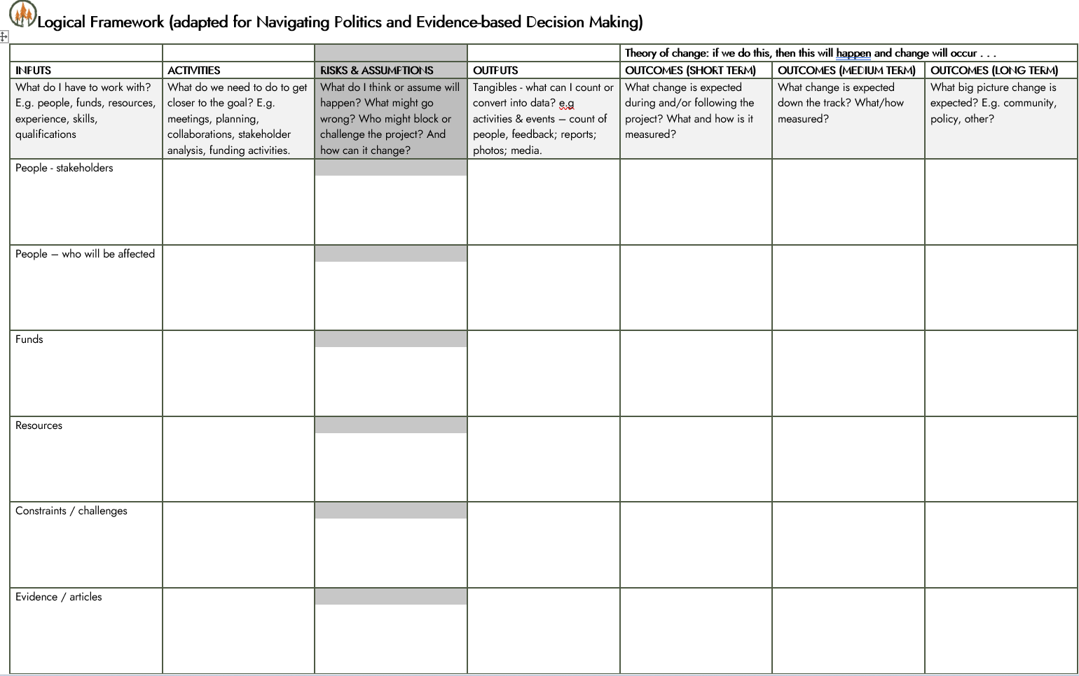
Create the story of how you perceive the solution or project will work.
Then challenge the assumptions and constraints.
What change will occur following the event or project?
What are the steps needed to get to your end goal?
Think end game:
List your organisation’s KPIs or key outcomes.
List funder & partner KPIs & priorities.

Slide 8
Scenario:
Your program or service manager has acquired funding for a Youth Social group, supporting people with a disability.
How would you plan the project using this template?

Slide 9
Summary
Be clear on what the ‘Who’, ‘Why’ and ‘What’.
Understand the project and stakeholders’ purpose, priorities and mission.
Plot out the information in any order.
Consider risks and assumptions – Is this wanted? What can go wrong? Who can block the process, when or where? How will it facilitate change? Might there be unintended consequences?
Include a range of evidence to back up your plan and purpose.
Align each stakeholder priorities with the project objectives.
9

Slide 10
Article: A Leader’s Framework for Decision Making
https://hbr.org/2007/11/a-leaders-framework-for-decision-making
Templates: Tools4Dev
https://tools4dev.org/
Download Redwoods templates
https://redwoodswc.com.au/logframe
10

Slide 11
Wrap up and Questions?
Thank you for your time!
Let me know your thoughts:
List key takeaways from this session in the Chat
Please get in touch with feedback, further questions and comments:
Tania Krasinski, Founder & Director
Redwoods Work Collaborative
M 0435 754 456 tania@redwoodswc.com.au
Templates https://redwoodswc.com.au/logframe
11

